Slide 1

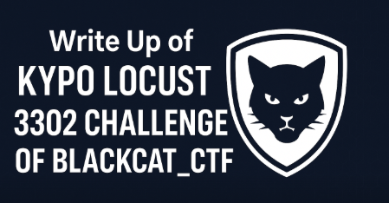



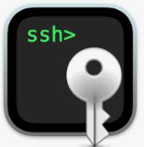
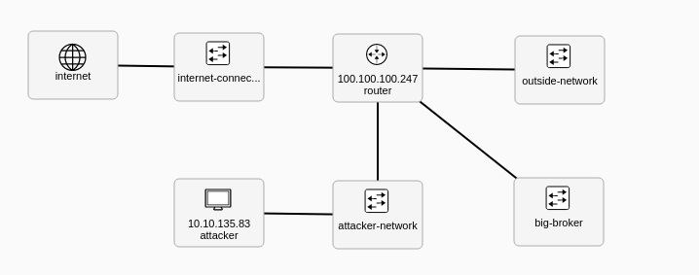


CTF Challenge Write Up : KYPO Locust 3302 Challenge of Blackcat
Task 1: Scan the IP address and port
Taks 5: Access the secret server
Task 6: Steal secret information from the other server
Task 2: Identify a vulnerability
Task 4: Find an IP address of the secret server
Task 3: Exploit the vulnerability

